Slide 1
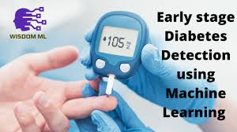

Slide 2
Diabetes is a common condition. The CDC found that 30.3 million adults in the U.S. have diabetes. They also estimate that 80.4 million adults have prediabetes.
Diabetes can be difficult to live with and be expensive to treat. Therefore, diagnosing diabetes early can be extremely helpful to a persons way of life and wallet.

Slide 3
What are the most common symptoms of diabetes?
Age
Gender
Polyuria
Polydipsia
Sudden Weight Loss
Weakness
Polyphagia
Genital Thrush
Visual Blurring
Itching
Irritability
Delayed Healing
Partial Paresis
Muscle Stiffness
Alopecia
Obesity
Class

Slide 4
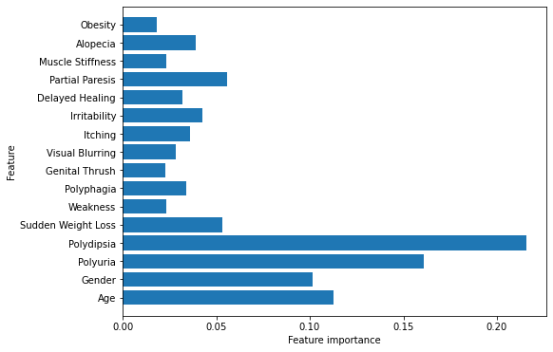
How much do these symptoms relate to early diabetes detection?

Slide 5
Using GradiantBoosterClassifier, diabetes can be predicted with 98.5% accuracy.

Slide 6
Conclusion
Early detection of diabetes can be very beneficial to a person way of life and to their pocketbook. Machine learning can help predict diabetes with 98.5 % accuracy.

